Slide 1

Airbnb Hotel Booking Analysis
Souradeep Datta
Apply ID: APPLY_175604520268ab1f92c978b
Internship ID: INTERNSHIP_17546440516895be537820f

Slide 2

PROBLEM STATEMENT
Airbnb is a popular platform where property owners rent out their homes or apartments to travelers. One of the big challenges for hosts is deciding the right price for their listings, since prices vary depending on several factors such as the number of bedrooms, number of bathrooms, cleanliness, accuracy of descriptions, a communication quality with guests.

Slide 3
Project Description
This project focuses on building a machine learning mode predict the price of Airbnb listings. Pricing an Airbnb property correctly is crucial for h hosts and travelers: hosts want to maximize occupancy and earnings, while travelers want fair and competitive prices. Using historical Airbnb data, the project develops a regression model that learns relationships between listing attributes (such as number of bedrooms, bathrooms, and guest ratings) and the price charged. The model can then be used to predict prices for new or hypothetical listings, helping property owners make informed pricing decisions.

Slide 4

WHO ARE THE END USERS?
Airbnb Hosts
Travelers
Airbnb Platform Analysts
Researchers/Students

Slide 5

Technology Used
Python
Pandas & Numpy
Scikit-learning
Matplotlib/Seaborn
Google colab
File handling libraries

Slide 6
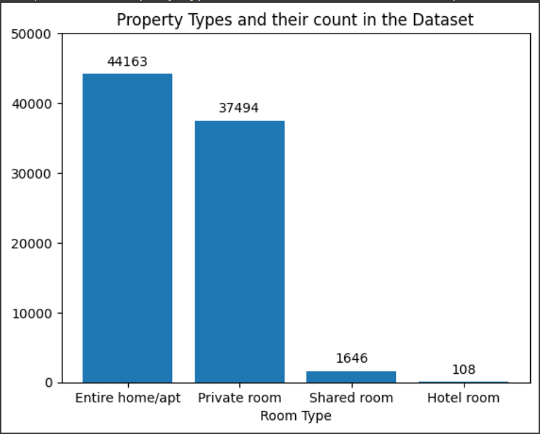
RESULTS1

Slide 7
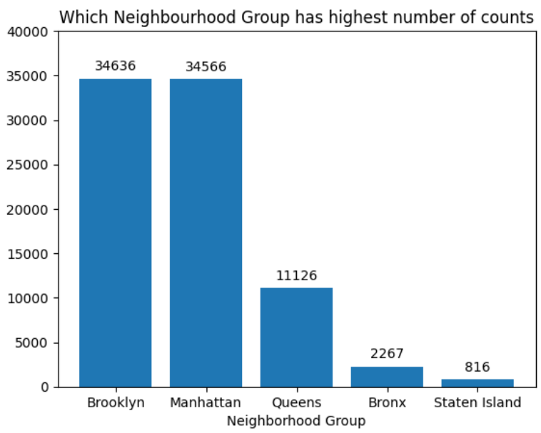
RESULTS2

Slide 8
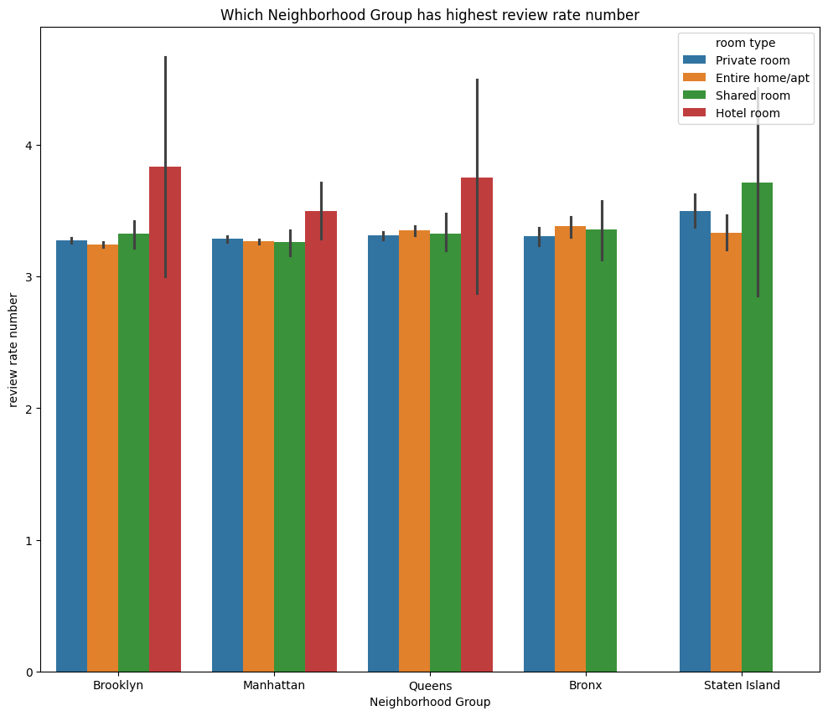
RESULTS3

Slide 9
GitHub repository
https://github.com/X3COR/VOIS_AICTE_Oct2025_SouradeepDatta.git
Demo Link

Slide 10

Getting started with Basics of Python Certificate

Slide 11

Data Visualization Certificate

Slide 12
Thank you
.
.

